Slide 1
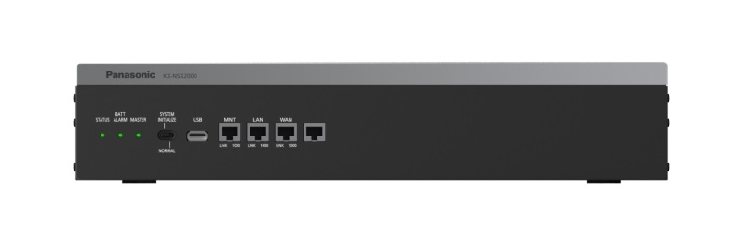
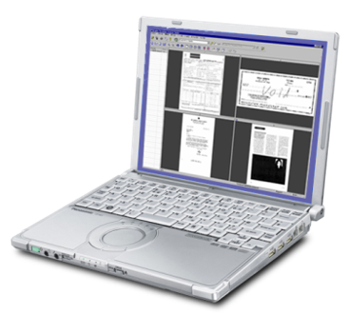
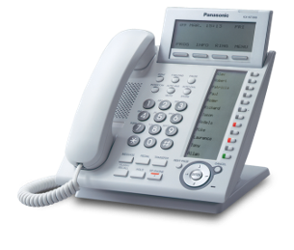

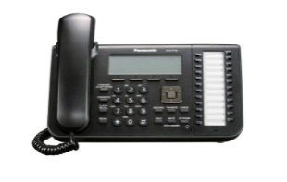
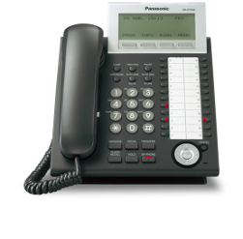
KX-NSX1000/2000
Smart Desk
Rev1.2 17 May., 2016
Notes:
1

Slide 2
Table of Contents
Chapter1 Overview
Chapter2 How it work?
Chapter3 How to program?

Slide 3
Chapter 1
Overview

Slide 4
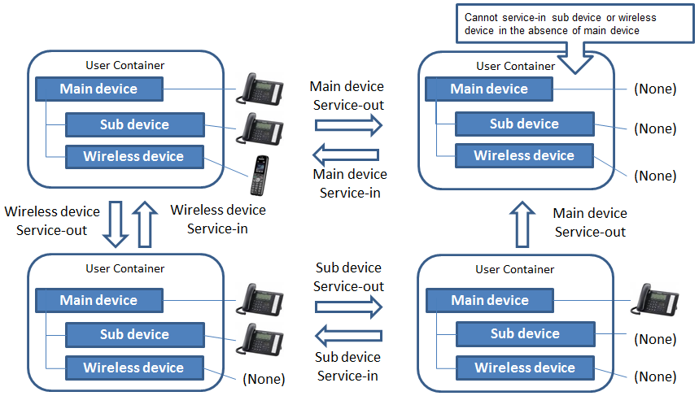
1. Overview
Smart Desk Behavior
Service-out means;
-Device which is at unavailable
status.
-Device which does not belong to
any user.
-Device which is available to initiate
Service-in operation.
Due to this implementation
No “Walking EXT” feature on NSX
In case “Service Out “ status
only Emergency call available
Useful feature at free layout office or call center agent.
The way of thinking is similar to ICD-Group log in/out.

Slide 5


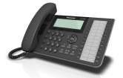



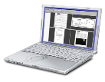
1. Overview
FWD can be set at any device belong
to user.
Due to user concept there is no Parallel
ringing with mobile feature on NSX.
IRNA can be deployed as call
backup after FWD.
UM mailbox can be set as IRNA destination.
FWD, IRNA enable/disable can be set during
All Service Out.
Smart Desk
Free layout Office
Port J
<Main Device>
Service IN->Out
User 300
Company
Outside
Company
Remote office
Port K
<Main Device>
Service Out->In
User 300
Normal user
Port L
<Main Device>
Service IN->Out
User 300
Port P
<Sub Device>
IP-Softphone
Service Out->IN
User 300
Port L
<Main Device>
Service IN
User 300
Port N
<Sub Device>
Service Out->In
User 300
Advanced user

Slide 6
Chapter 2
How it work?

Slide 7
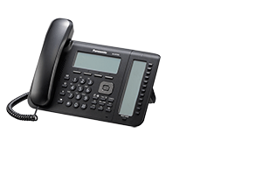
2. How it works?
Smart Desk
Due to this implementation
No “Walking EXT” feature on NSX
Service-In : An user logs on the device. Then this device is tied with this user.
Service-Out : An user logs off the device. Then this device is not tied with any user.
Only Service-In operation and Emergency call are available.
Service-Out
Service-In
No User
Service-In
Available as EXT xxx
Service-Out
No EXT Number is allocated

Slide 8
2. How it works?
Service-Out
Smart Desk
No User
Due to this implementation
No “Walking EXT” feature on NSX
Service-In
Service-In
Available as EXT xxx
Service-Out
No EXT Number is allocated
Feature Code type | Behavior | Additional dial
Main Device Service-In | Main Device become active | Main EXT number and password
Sub Device Service-In | Sub Device become active | Main EXT number and password
Wireless Device Service-In | Wireless Device become active | Main EXT number and password
Service-Out | Device become In active | password

Slide 9
2. How it work?
Smart Desk -Operation-
Service-OUT
START
Enter Extension Number
Enter user container number
as extension number
XXXX
Enter PIN
****
21 OCT. 21:53 TUE
This terminal becomes Main Device

Slide 10
2. How it work?
Smart Desk -Condition-
<Supported devices>
Following devices are available for this feature.
IP-PT, DPT, SLT, DECT-PS, Panasonic IP-softphone
Note: 3rd party SIP phone and KX-HDV series, KX-UT series, KX-TGP600,
DSS console (KX-DT590/390), are not supported.
Phone that has DSS console (KX-DT590/390) attached can’t be Service-out.
Phone that has Key module (KX-NT303/305/505) attached can be Service-out.

Slide 11
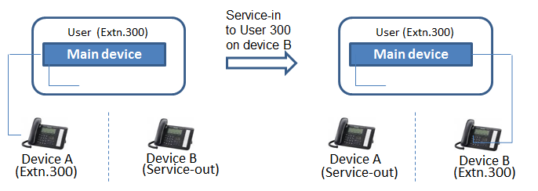
2. How it work?
Smart Desk -Condition-
While service-out status, most of service are limited and only service-in operation and emergency call are available.
User, who has already service-in device, can service-in from other device which is in service-out. The original service-in device is into service-out automatically.
The login / logout of ICD group can be performed in conjunction with service- in / service- out. This is system option.

Slide 12
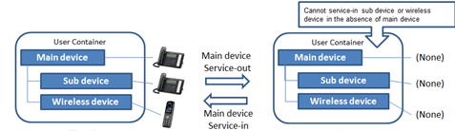
2. How it work?
Smart Desk -Condition-
Service-out operation is initiated at main device then all device(s) tied with the main device is(are) became Service-out status.
However “tied” information will be kept unless some other user initiate Service-in at such device.
This means, such kept information will be validate when initiate Service-in.
Same devices become Service-in state as before.

Slide 13
2. How it work?
Smart Desk -Condition-
-XDP Connection
Telephone which is connected by XDP to DPT connect with DHLC has XDP
connection will not move together with Smart Desk operation. Thus both
telephone work independently.
-Mobile device and Mailbox
Tied setting to main device will not be deleted by Smart Desk operation.
-Simplified Isolated Mode
Smart Desk feature can’t be operated during this mode.
All device belong to ExpGW work as normal Extension.
-Smart Desk operation through DISA
Not available
-Smart Desk operation by CTI application
Not available

Slide 14
2. How it work?
Smart Desk -Condition-
-During all device tied to single user at “Service-Out” state,
The call for this user will be treated by either IRNA or FWD ALL depending on
programming.
FWD ALL : Activate this call treatment by System Option
1)FWD ALL：Enable/The call for all device Service-Out state user will be
(Same behavior In case no FWD destination setting at User)
Call => User X(all devices service out) => call divert to FWD destination =>IRNA destination
2) FWD ALL :Disable/The call for all device Service-Out state user will be
Call => User X(all devices service out) =>IRNA destination

Slide 15
Chapter 3
How to program?

Slide 16
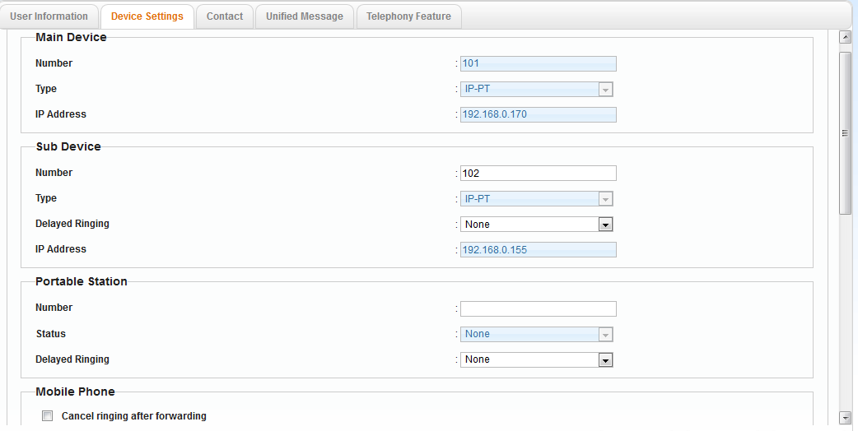
3. How to program?
Need EXT number setting for each user who want to use Service-in/out with
Sub or PS. In bellow case Sub Device can use ServieIn/Out but not Service
In by PS thus no PS EXT Number is assigned.

Slide 17
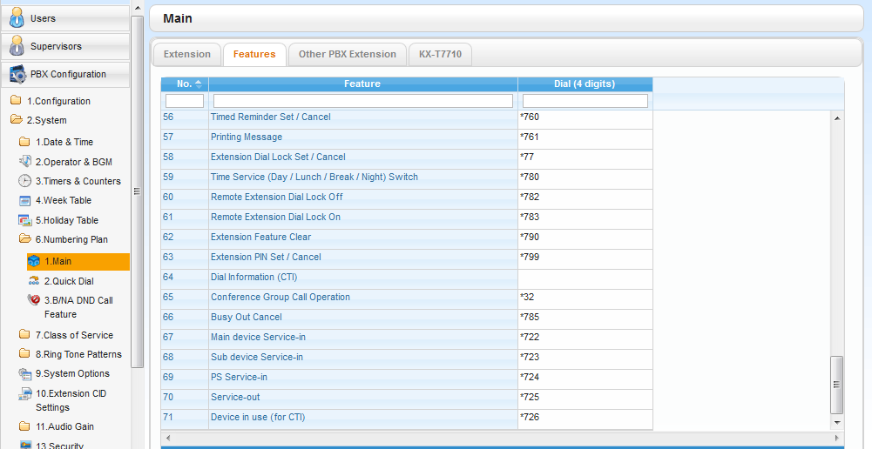
3. How to program?
Phone Number for Device Service-in/out
- Main device Service-in : *722
- Sub devise Service-in : *723
- PS Service-in : *724
- Service-out : *725

Slide 18
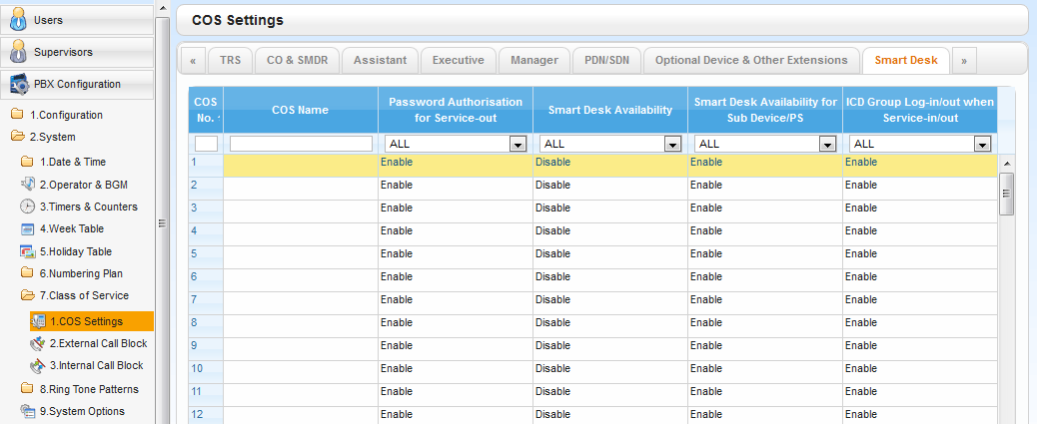
3. How to program?
COS setting for Smart Desk
Smart Desk
When you use this feature,
must be “enable”
- Password Authorisation for Service-out
- Smart Desk Availability
- Smart Desk Availability for Sub Device/PS
- ICD Group Log-in/out when Service-in/out

Slide 19
3. How to program?
COS setting for Smart Desk
-Password Authorisation for Service-out : Specifies whether to enable Password
Authorisation for Service-out.
Enable/Disable
-Smart Desk Availability Specifies whether to enable Hot Desking Availability.
Enable/Disable
-Smart Desk Availability for Sub Device/PS : Specifies whether to enable Hot Desking
Availability for sub devices and PSs.
Enable/Disable
ICD Group Log-in/out when Service-in/out : Specifies whether to enable ICD Group Login/out when performing Service-in/Service-out.
Enable/Disable

Slide 20
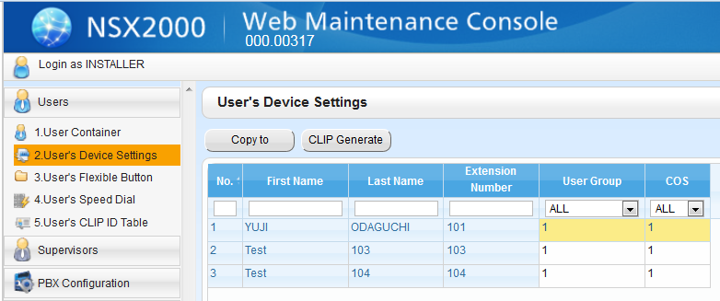
3. How to program?
COS setting for each User

Slide 21
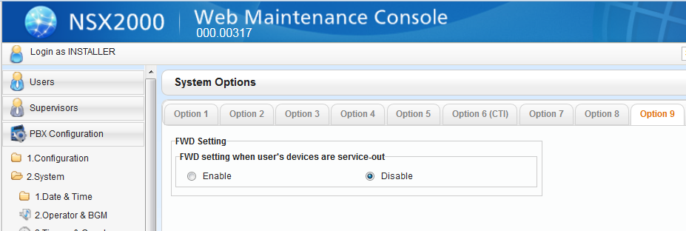
3. How to program?
-FWD all setting applied during all device service out from the user.
This setting is system wise.

Slide 22
Thank you ! The END

Slide 23
Modification
5.6_NSX1000_2000_SmartDesk_Rev1.0_8Jan2016.pptx
- 1st release
5.6_NSX1000_2000_SmartDesk_Rev1.2_17May2016.pptx
- Add slide 16

